Slide 1

CE303
Advanced Programming
Unit 3. Nov 1st, 2022.
Notes:
Caught in a landslide

Slide 2
Today:
Reading, writing, and copying objects with Java
Notes:
“Why should we care?” / “What will this unit enable us to do?”

Slide 3

Notes:
Juggle all sorts of objects, pass them around effectively (within the same program … between programs … between applications or files in your operating system / filesystem …)

Slide 4
Notes:
Juggle all sorts of objects, pass them around effectively (within the same program … between programs … between applications or files in your operating system / filesystem …)

Slide 5
Overview
How to copy objects
Deep vs Shallow copying (or cloning)
Input / Output streams
Serialisation
What is JSON?
And libraries that make use of it (GSON)

Slide 6
BUT, FIRST,

Slide 7
BUT, FIRST,
POP QUIZ, HOTSHOTS!

Slide 8
BUT, FIRST,
POP QUIZ, HOTSHOTS!
( A.K.A quick recap on last week’s stuff! )

Slide 9

TODO
Notes:
You are Ethan Hawke, in the movie GATTACA, where the future is bleak, and your DNA decides your fate.
You have been using Jude Law’s DNA, to pretend you’re of acceptable DNA, to go to the moon.
However, Uma Thurman is suspecting you. She’s called the authorities to come and swab your desk!
You need to create some more DNA samples, and plant them on your desk, FAST!
What do you do?

Slide 10
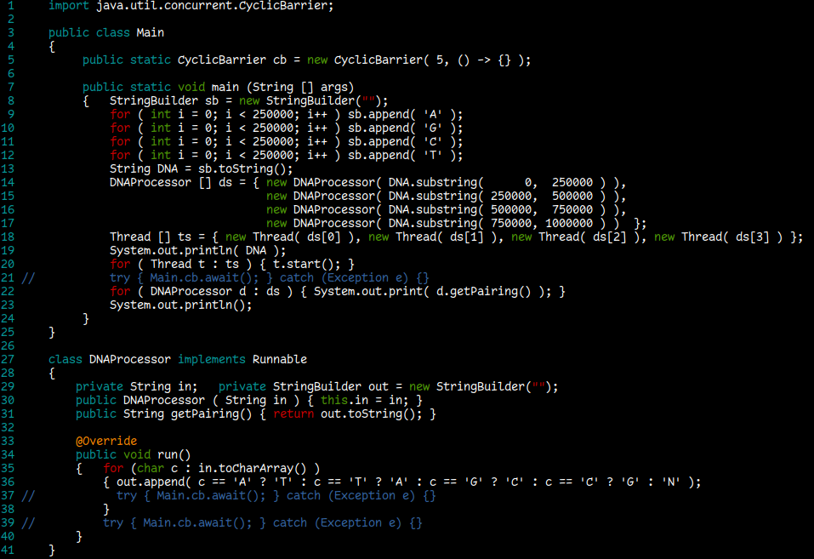
TODO
Notes:
Complementary bases
Adenine <-> Thymine
Guanine <-> Cytosine

Slide 11
TODO
https://pollev.com/ce303
Notes:
Complementary bases
Adenine <-> Thymine
Guanine <-> Cytosine

Slide 12
Part 1:
Copying Objects: Deep vs Shallow copying

Slide 13
Types, Values, and Variables
Java is a ‘statically typed’ language, which means:
Every variable and every expression has a ‘type’ that is known (and checked!) at compile time
Type checking verifies type safety, i.e. that arguments passed to all operations are of the correct type
By contrast dynamically-typed languages perform type checking at runtime
Typically, type information is not available at compile-time, and object types are determined only at runtime
Sources for further reading:
Java SE Specification, Chapter 4: https://docs.oracle.com/javase/specs/jls/se17/html/jls-4.html
Java Virtual Machine Guide: https://docs.oracle.com/en/java/javase/17/vm/support-non-java-languages.html )
Notes:
Before we discuss how to ‘copy’ objects, let’s first discuss how java treats objects in the first place.
Examples of dynamic languages: python, ruby, matlab/octave, R, javascript

Slide 14
Types, Values, and Variables
Java is considered a ‘strongly typed’ language:
Languages with strong typing specify restrictions on the types of values supplied to its operations, and prevent the execution of an operation if its arguments have the wrong type.
Languages with weak typing may implicitly convert (or cast) arguments of an operation if those arguments have the wrong or incompatible types.
Strong static typing helps detect errors at compile time
In practice, strong and weak are part of a spectrum, not a ‘black and white’ distinction.
Languages can be static+strong (Java/C#/Haskell), static+weak (c/c++), dynamic+strong (python/ruby), or dynamic+weak (javascript/R/).
Java is considered strongly typed, because types generally limit the values that a variable can hold, or that an expression can produce, limit the operations supported on those values, or determine the meaning of operations.
However, some implicit conversions do take place, e.g. upcasting, boxing/unboxing, widening
E.g. Base b = Subclass(); Integer i = 5; int i = Integer.valueOf(5); int c = ‘c’;

Slide 15
Types, Values, and Variables
Java has two kinds of types: Primitive types, and Reference Types.
Primitive Types: boolean type, and “numeric” types: (byte, short, int, long, char, float, double)
Reference Types: Classes, Interfaces, Arrays, and ‘null’ type
The ‘null’ type is a nameless type, corresponding to the type of the expression null.
Values: data (i.e. digital) representation in memory
Can be ‘stored’ in variables, passed as arguments, returned by methods, operated on, etc
Values of primitive types reside directly on the thread’s stack
Values of reference types are effectively references (i.e. pointers) to actual data which resides on the heap.
The reference itself (i.e. the “pointer”) resides on the stack, but is generally not accessible to the Java programmer
The uniqueness of the object on the heap can be inspected via its HashCode.
A variable is a label associated with a type, which can be assigned a value.
A variable of a primitive type always holds a primitive value of the exact primitive type.
A variable of a reference type, contains reference values (or just references): these can either be pointers to objects (i.e. class instances or arrays), or the special null reference value, which refers to no object.
Notes:
A ‘Type’ in the mathematical sense (e.g. Category Theory) can be thought of as a rule that can be used to create concrete ‘things’.
Sets are concrete in nature, and deal with things as 'collections'.
Types are abstract in nature, and deal with things as 'constructions’.
A set is a collection of elements, and this collection describes the set in its totality.
A type is a statement, which describes what can be 'constructed' according to some rules.
There is the concept of the 'expression' of a type, which is a set. This can be thought of as the act of making all elements under the type 'concrete', and collecting them as a set.
The reciprocal of this is describing / defining a set as the collection of elements 'having a particular property'.

Slide 16
Compare, e.g., with c:
# include <stdio.h>
# include <stdlib.h>
struct MyStruct { int a; int b; };
int main( void )
{ int a = 5; // allocate memory on stack for type int, initialise with value at the same time
struct MyStruct b = { .a = 1, .b = 2 }; // allocate memory on stack for type struct MyStruct, and initialise on the spot
int * c = malloc( sizeof( int ) ); // allocate memory on stack for a pointer (of type int) and initialise via malloc
struct MyStruct * d = malloc( sizeof( struct MyStruct ) ); // allocate memory on stack for a pointer
// (of type struct MyStruct), and initialise
(* c) = 10; d -> a = 3; d -> b = 4; // Assign values at the (heap) memory locations pointed to by c and d.
printf( "a: %d, b: {%d, %d}\n", a, b.a, b.b );
printf( "c points to heap address %p where value %d is stored\n", c, *c );
printf( "d points to heap address %p where struct with values {%d, %d} is stored\n", d, d->a, d->b );
free(c); free(d); // Memory allocated on the heap must be explicitly free’d. a and b will be free’d automatically.
return 0;
}
Notes:
Compare with accessing heap objects via pointers in c, vs objects created directly on the stack – entirely in the programmers control

Slide 17
Compare, e.g., with c:
/* Compare with Java */
class MyClass
{ int a; int b;
public MyClass( int a, int b ) { this.a = a; this.b = b; }
}
public class Main
{
public static void main( String [] args )
{
int a = 5; // primitive => initialised on the stack
MyClass b = new MyClass( 1, 2 ); // reference (new) => initialised on the heap
System.out.println( "a=" + a + " b=" + b ); // values interpreted according to
// operation and type involved
}
}
// Output: a=5 b=MyClass@4e0e2f2a
# include <stdio.h>
# include <stdlib.h>
struct MyStruct { int a; int b; };
int main( void )
{ int a = 5; // allocate memory on stack for type int, initialise with value at the same time
struct MyStruct b = { .a = 1, .b = 2 }; // allocate memory on stack for type struct MyStruct, and initialise on the spot
int * c = malloc( sizeof( int ) ); // allocate memory on stack for a pointer (of type int) and initialise via malloc
struct MyStruct * d = malloc( sizeof( struct MyStruct ) ); // allocate memory on stack for a pointer
// (of type struct MyStruct), and initialise
(* c) = 10; d -> a = 3; d -> b = 4; // Assign values at the (heap) memory locations pointed to by c and d.
printf( "a: %d, b: {%d, %d}\n", a, b.a, b.b );
printf( "c points to heap address %p where value %d is stored\n", c, *c );
printf( "d points to heap address %p where struct with values {%d, %d} is stored\n", d, d->a, d->b );
free(c); free(d); // Memory allocated on the heap must be explicitly free’d. a and b will be free’d automatically.
return 0;
}
Notes:
Compare with accessing heap objects via pointers in c, vs objects created directly on the stack – entirely in the programmers control

Slide 18
Are arrays ‘objects’?
Tend not to view them as such
Partly because of the specialised syntax used to create array ‘objects’ of a particular array type, instead of the more typical class constructor syntax.
… but, actually, yes!
“In the Java programming language, arrays are objects (§4.3.1), are dynamically created, and may be assigned to variables of type Object (§4.3.2).”
The direct superclass of an array type is Object; all methods of class Object may be invoked on an array.
Every array type implements the interfaces Cloneable and java.io.Serializable.
Java defines a corresponding class for every array type (i.e. there’s a class for int[] and similarly for float, double etc). However, these are part of the java language, and generally not available to the programmer.
Having said that, their classnames can be inspected like in normal objects:
System.out.println( (new int [] { 1,2,3,4,5 }).getClass().getName() ); // outputs: [I
(source: https://www.geeksforgeeks.org/array-primitive-type-object-java )
Notes:
Remind the standard output from toString, which is the classname and Hashcode

Slide 19
Aliasing: Copying References
Assigning the value of a reference type variable to another such variable creates an ‘alias’. I.e. the two variables represent different labels/handles to the same object in memory. E.g.
Caveat: Independent but otherwise ‘equal’ String objects may be “interned” by the compiler
(i.e. replaced by a single reference)
public class Main
{ public static void main( String [] args )
{ String a = "Greetings"; String b = "Salutations"; String c = a;
System.out.println( “ “ + Integer.toUnsignedString( a.hashCode() ) );
System.out.println( “ “ + Integer.toUnsignedString( b.hashCode() ) );
System.out.println( “ “ + Integer.toUnsignedString( c.hashCode() ) );
System.out.println( “ “ + a == b ); System.out.println( “ “ + a == c );
}
}
// Output: 4077102906 2167350587 4077102906 false true
Notes:
Caveat: Interned strings

Slide 20
Aliasing: Copying References
Primitive types are passed to methods by value.
Technically speaking, the reference values (i.e. pointers) of reference type variables are also passed by value
But the java programmer is blind to this process
Passing an object / variable to a method (which is then captured under a parameter name inside the method) means creating an alias that the method can use to refer to that object in memory. (i.e. “passing a reference”)
It does not pass / make a copy of the object!
Copying references is much faster / requires less memory compared to ‘cloning’ an object inside the method (i.e. copying the values of all the fields to a new object).
But sometimes you may actually wish to create such a copy / clone of an object.

Slide 21
Cloning in Java
Class Object defines a protected Object clone() method
The clone() method creates and returns a “shallow” copy of a (subclassing) object.
Same class as the original (subclassing) object (i.e. which extends Object, thus inheriting clone() )
Primitive type fields: values are copied
Non-primitive type fields: aliasing, e.g. copying of the reference only
If you want to invoke Object.clone() on an object (e.g. via super), then the class of that object should implement the Cloneable interface.
If it does not, then Object.clone() will throw a CloneNotSupportedException

Slide 22
class MyClass implements Cloneable
{ int i;
public MyClass( int x ) { this.i = x; }
public Object clone() throws CloneNotSupportedException { return super.clone(); }
public boolean equals( MyClass b ) { return this.i == b.i; }
}
public class Main
{
public static void main( String [] args )
{
MyClass a = new MyClass(1);
MyClass b;
try { b = (MyClass) a.clone(); }
catch (CloneNotSupportedException e) { e.printStackTrace(); b = null; System.exit(1); }
System.out.print( " " + a );
System.out.print( " " + b );
System.out.print( " " + (a == b) );
System.out.print( " " + a.equals(b) );
}
}
// Outputs: MyClass@7344699f MyClass@6b95977 false true
Notes:
Let’s go through this example.

Slide 23

class MyClass implements Cloneable
{ int i;
public MyClass( int x ) { this.i = x; }
public Object clone() throws CloneNotSupportedException { return super.clone(); }
public boolean equals( MyClass b ) { return this.i == b.i; }
}
public class Main
{
public static void main( String [] args )
{
MyClass a = new MyClass(1);
MyClass b;
try { b = (MyClass) a.clone(); }
catch (CloneNotSupportedException e) { e.printStackTrace(); b = null; System.exit(1); }
System.out.print( " " + a );
System.out.print( " " + b );
System.out.print( " " + (a == b) );
System.out.print( " " + a.equals(b) );
}
}
// Outputs: MyClass@7344699f MyClass@6b95977 false true
Notes:
Let’s change this slightly

Slide 24
class MyClass // does not need to implement Cloneable!
{ int i;
public MyClass( int x ) { this.i = x; }
public Object clone() throws CloneNotSupportedException { return (Object) new MyClass( this.i ); }
public boolean equals( MyClass b ) { return this.i == b.i; }
}
public class Main
{
public static void main( String [] args )
{
MyClass a = new MyClass(1);
MyClass b;
try { b = (MyClass) a.clone(); }
catch (CloneNotSupportedException e) { e.printStackTrace(); b = null; System.exit(1); }
System.out.print( " " + a );
System.out.print( " " + b );
System.out.print( " " + (a == b) );
System.out.print( " " + a.equals(b) );
}
}
// Outputs: MyClass@7344699f MyClass@6b95977 false true
Notes:
Now we’re “copying” the fields manually
Note we could still implement Cloneable, since we’re overriding a .clone() method
But our method doesn’t check if our ‘this’ object is an instance of Cloneable and throw an exception if not!

Slide 25
class MyClass // does not need to implement Cloneable!
{ int i;
public MyClass( int x ) { this.i = x; }
public Object clone() throws CloneNotSupportedException { return (Object) new MyClass( this.i ); }
public boolean equals( MyClass b ) { return this.i == b.i; }
}
public class Main
{
public static void main( String [] args )
{
MyClass a = new MyClass(1);
MyClass b;
try { b = (MyClass) a.clone(); }
catch (CloneNotSupportedException e) { e.printStackTrace(); b = null; System.exit(1); }
System.out.print( " " + a );
System.out.print( " " + b );
System.out.print( " " + (a == b) );
System.out.print( " " + a.equals(b) );
}
}
// Outputs: MyClass@7344699f MyClass@6b95977 false true
Notes:
Therefore main will not complain that we removed Cloneable.
(but it would still be good practice to include the ‘implement’ instruction, to signal to users of our class that it provides a .clone() method)

Slide 26
More considerations on Cloneables
It is typically preferred to write your own method for copying objects of a class
See https://stackoverflow.com/questions/26398951/why-is-cloneable-not-deprecated
It is normally expected that:
The cloned object is equal to the original object (e.g. x.clone().equals(x) evaluates to true )
The cloned object is of the same type as the original object (e.g. x.clone().getClass() == x.getClass() )
There is generally no need to clone immutable objects – use aliases instead
Notes:
Lots of problems with Cloneables (including spelling!). Original authors regret its implementation.
Points 2.1 and 2.2 on this list make me hypocritical, because:
2.1: When one implements the equals method, generally they’re generally also expected to implement the hashCode method (e.g. for memory efficiency; similar to interned Strings).
2.2: I didn’t do this in the previous example (show it).
Also note the example of downcasting here (MyClass -> Object -> MyClass)

Slide 27
“Shallow” vs “Deep” Copying
import java.util.ArrayList; import java.util.List;
public class Book implements Cloneable
{ public String isbn; public double price; public String title; public List< Author > authors;
public Book( String title, String isbn, double price, List< Author > authors )
{ this.title = title; this.isbn = (isbn == null ? "" : isbn); this.price = price; this.authors = new ArrayList<>();
if (authors != null) { this.authors.addAll( authors ); } // note: this is a new Array, not a reference to one
} // Shallow! ↴
public Book clone() throws CloneNotSupportedException { return (Book) super.clone(); }
public String toString() { return "Book [" + title + "]"; }
public static void main( String[] args ) throws CloneNotSupportedException
{ Author author1 = new Author( "id1", "name1" ); Author author2 = new Author( "id2", "name2" );
List< Author > authorsDB = new ArrayList<>(); authorsDB.add( author1 ); authorsDB.add( author2 );
Book b = new Book( "book1", "", 10, authorsDB ); Book b2 = b.clone();
b.authors.remove( 0 ); authorsDB.add( new Author( "id3", "name3" ) );
for( Author A : authorsDB ) { System.out.print( " " + A ); } System.out.println();
for( Author A : b .authors ) { System.out.print( " " + A ); } System.out.println();
for( Author A : b2.authors ) { System.out.print( " " + A ); } System.out.println();
}
}
Notes:
Let’s study this example a bit (apologies for the ‘compressed’ lines!)
The Author class is not shown here, but it’s exactly what you imagine it to be ☺
Btw, all this code will be available on moodle (properly spaced!) for you to study later if you want to.

Slide 28
“Shallow” vs “Deep” Copying
import java.util.ArrayList; import java.util.List;
public class Book implements Cloneable
{ public String isbn; public double price; public String title; public List< Author > authors;
public Book( String title, String isbn, double price, List< Author > authors )
{ this.title = title; this.isbn = (isbn == null ? "" : isbn); this.price = price; this.authors = new ArrayList<>();
if (authors != null) { this.authors.addAll( authors ); } // note: this is a new Array, not a reference to one
} // Shallow! ↴
public Book clone() throws CloneNotSupportedException { return (Book) super.clone(); }
public String toString() { return "Book [" + title + "]"; }
public static void main( String[] args ) throws CloneNotSupportedException
{ Author author1 = new Author( "id1", "name1" ); Author author2 = new Author( "id2", "name2" );
List< Author > authorsDB = new ArrayList<>(); authorsDB.add( author1 ); authorsDB.add( author2 );
Book b = new Book( "book1", "", 10, authorsDB ); Book b2 = b.clone();
b.authors.remove( 0 ); authorsDB.add( new Author( "id3", "name3" ) );
for( Author A : authorsDB ) { System.out.print( " " + A ); } System.out.println();
for( Author A : b .authors ) { System.out.print( " " + A ); } System.out.println();
for( Author A : b2.authors ) { System.out.print( " " + A ); } System.out.println();
}
}
Output:
Author[id1, name1] Author[id2, name2] Author[id3, name3]
Author[id2, name2]
Author[id2, name2]

Slide 29
“Shallow” Book Cloning
In the clone, the price is of primitive type, so its value is copied directly from the original. Therefore the two objects have the same value for price.
In the clone, the fields isbn, title and authors refer to the same objects as the original (i.e. the reference value has been copied from the original to the clone).
This is not a problem for isbn and title because strings are immutable in Java.
In other words, a string object’s content cannot change “in-place”. If you change the string, you are necessarily assigning a new String object to that field, which is a different object from that of the original
But! The mutable authors list will be shared between the original and the clone!
They are not independent objects!
“Mutating” the list (i.e. updating the contents of this List object “in-place”, without creating / assigning a new list object) via one of the objects, will be reflected in both objects.

Slide 30
“Shallow” Book Cloning
Original
Clone
isbn
price=22.00
title
authors
"978-0007120765"
isbn
price=22.00
title
authors
"The Mystery of the Blue Train"
List<Author>
id
name
"AGAT"
"Christie, Agatha"

Slide 31
“Shallow” vs “Deep” Copying
import java.util.ArrayList; import java.util.List;
public class Book implements Cloneable
{ public String isbn; public double price; public String title; public List< Author > authors;
public Book( String title, String isbn, double price, List< Author > authors )
{ this.title = title; this.isbn = (isbn == null ? "" : isbn); this.price = price; this.authors = new ArrayList<>();
if (authors != null) { this.authors.addAll( authors ); } // note: this is a new Array, not a reference to one
} // Shallow! ↴
public Book clone() throws CloneNotSupportedException { return (Book) super.clone(); }
public String toString() { return "Book [" + title + "]"; }
public static void main( String[] args ) throws CloneNotSupportedException
{ Author author1 = new Author( "id1", "name1" ); Author author2 = new Author( "id2", "name2" );
List< Author > authorsDB = new ArrayList<>(); authorsDB.add( author1 ); authorsDB.add( author2 );
Book b = new Book( "book1", "", 10, authorsDB ); Book b2 = b.clone();
b.authors.remove( 0 ); authorsDB.add( new Author( "id3", "name3" ) );
for( Author A : authorsDB ) { System.out.print( " " + A ); } System.out.println();
for( Author A : b .authors ) { System.out.print( " " + A ); } System.out.println();
for( Author A : b2.authors ) { System.out.print( " " + A ); } System.out.println();
}
}
Output:
Author[id1, name1] Author[id2, name2] Author[id3, name3]
Author[id2, name2]
Author[id2, name2]

Slide 32

“Shallow” vs “Deep” Copying
import java.util.ArrayList; import java.util.List;
public class Book implements Cloneable
{ public String isbn; public double price; public String title; public List< Author > authors;
public Book( String title, String isbn, double price, List< Author > authors )
{ this.title = title; this.isbn = (isbn == null ? "" : isbn); this.price = price; this.authors = new ArrayList<>();
if (authors != null) { this.authors.addAll( authors ); } // note: this is a new Array, not a reference to one
} // Shallow! ↴
public Book clone() throws CloneNotSupportedException { return (Book) super.clone(); }
public String toString() { return "Book [" + title + "]"; }
public static void main( String[] args ) throws CloneNotSupportedException
{ Author author1 = new Author( "id1", "name1" ); Author author2 = new Author( "id2", "name2" );
List< Author > authorsDB = new ArrayList<>(); authorsDB.add( author1 ); authorsDB.add( author2 );
Book b = new Book( "book1", "", 10, authorsDB ); Book b2 = b.clone();
b.authors.remove( 0 ); authorsDB.add( new Author( "id3", "name3" ) );
for( Author A : authorsDB ) { System.out.print( " " + A ); } System.out.println();
for( Author A : b .authors ) { System.out.print( " " + A ); } System.out.println();
for( Author A : b2.authors ) { System.out.print( " " + A ); } System.out.println();
}
}

Slide 33
“Shallow” vs “Deep” Copying
import java.util.ArrayList; import java.util.List;
public class Book implements Cloneable
{ public String isbn; public double price; public String title; public List< Author > authors;
public Book( String title, String isbn, double price, List< Author > authors )
{ this.title = title; this.isbn = (isbn == null ? "" : isbn); this.price = price; this.authors = new ArrayList<>();
if (authors != null) { this.authors.addAll( authors ); } // note: this is a new Array, not a reference to one
} // Deep! ↴
public Book clone() throws CloneNotSupportedException {return new Book(this.title, this.isbn, this.price, this.authors);} public String toString() { return "Book [" + title + "]"; }
public static void main( String[] args ) throws CloneNotSupportedException
{ Author author1 = new Author( "id1", "name1" ); Author author2 = new Author( "id2", "name2" );
List< Author > authorsDB = new ArrayList<>(); authorsDB.add( author1 ); authorsDB.add( author2 );
Book b = new Book( "book1", "", 10, authorsDB ); Book b2 = b.clone();
b.authors.remove( 0 ); authorsDB.add( new Author( "id3", "name3" ) );
for( Author A : authorsDB ) { System.out.print( " " + A ); } System.out.println();
for( Author A : b .authors ) { System.out.print( " " + A ); } System.out.println();
for( Author A : b2.authors ) { System.out.print( " " + A ); } System.out.println();
}
}

Slide 34
“Shallow” vs “Deep” Copying
import java.util.ArrayList; import java.util.List;
public class Book implements Cloneable
{ public String isbn; public double price; public String title; public List< Author > authors;
public Book( String title, String isbn, double price, List< Author > authors )
{ this.title = title; this.isbn = (isbn == null ? "" : isbn); this.price = price; this.authors = new ArrayList<>();
if (authors != null) { this.authors.addAll( authors ); } // note: this is a new Array, not a reference to one
} // Deep! ↴
public Book clone() throws CloneNotSupportedException {return new Book(this.title, this.isbn, this.price, this.authors);} public String toString() { return "Book [" + title + "]"; }
public static void main( String[] args ) throws CloneNotSupportedException
{ Author author1 = new Author( "id1", "name1" ); Author author2 = new Author( "id2", "name2" );
List< Author > authorsDB = new ArrayList<>(); authorsDB.add( author1 ); authorsDB.add( author2 );
Book b = new Book( "book1", "", 10, authorsDB ); Book b2 = b.clone();
b.authors.remove( 0 ); authorsDB.add( new Author( "id3", "name3" ) );
for( Author A : authorsDB ) { System.out.print( " " + A ); } System.out.println();
for( Author A : b .authors ) { System.out.print( " " + A ); } System.out.println();
for( Author A : b2.authors ) { System.out.print( " " + A ); } System.out.println();
}
}

Slide 35
“Shallow” vs “Deep” Copying
import java.util.ArrayList; import java.util.List;
public class Book implements Cloneable
{ public String isbn; public double price; public String title; public List< Author > authors;
public Book( String title, String isbn, double price, List< Author > authors )
{ this.title = title; this.isbn = (isbn == null ? "" : isbn); this.price = price; this.authors = new ArrayList<>();
if (authors != null) { this.authors.addAll( authors ); } // note: this is a new Array, not a reference to one
} // Deep! ↴
public Book clone() throws CloneNotSupportedException {return new Book(this.title, this.isbn, this.price, this.authors);} public String toString() { return "Book [" + title + "]"; }
public static void main( String[] args ) throws CloneNotSupportedException
{ Author author1 = new Author( "id1", "name1" ); Author author2 = new Author( "id2", "name2" );
List< Author > authorsDB = new ArrayList<>(); authorsDB.add( author1 ); authorsDB.add( author2 );
Book b = new Book( "book1", "", 10, authorsDB ); Book b2 = b.clone();
b.authors.remove( 0 ); authorsDB.add( new Author( "id3", "name3" ) );
for( Author A : authorsDB ) { System.out.print( " " + A ); } System.out.println();
for( Author A : b .authors ) { System.out.print( " " + A ); } System.out.println();
for( Author A : b2.authors ) { System.out.print( " " + A ); } System.out.println();
}
}
Output:
Author[id1, name1] Author[id2, name2] Author[id3, name3]
Author[id2, name2]
Author[id2, name2] Author[id2, name2]

Slide 36
“Deep” Book Cloning
Original
Clone
isbn
price=22.00
title
authors
"978-0007120765"
isbn
price=22.00
title
authors
"The Mystery of the Blue Train"
List<Author>
List<Author>
id
name
"AGAT"
"Christie, Agatha"

Slide 37
“Deep” Book Cloning
Changes to this clone will not affect the original object and vice versa
Note that the Book constructor creates a new ArrayList object and assigns it to the authors field.
This is not an alias of the original’s object.
The ‘deep’ cloning process was manual.
May need to account for multiple levels of ‘depth’. E.g. if the Author objects comprising the “authors” list also contained mutable fields, each Author element would have been a ‘shallow’ copy…
But in this case, maybe this would have been desirable! E.g. if updating the “Authors Database”.
Notes:
We’ll see an example of this in the lab.

Slide 38
Considerations / weaknesses of cloning
Weaknesses of the unified cloning mechanism:
The compiler cannot guarantee that your implementation satisfies the expected conditions
There is nothing that indicates how deep your cloning is (you won’t know if it’s deep or shallow clone)
This doesn’t stop you from providing cloning functionality in other forms such as constructors or functions with self-explanatory names
E.g., a common pattern is the use of a so-called “copy constructor”: a constructor which takes an object of the same type as input, and copies all its fields (typically used for creating a deep copy).
e.g.: Book b = new Book( (Book) a );
Alternatively, you could create a user-defined copy() method, which returns new instances populated with the right values via a standard constructor.
Both the above could be valid ways to work around having to implement the Cloneable interface and having to handle a CloneNotSupportedException.
Notes:
Note that the Object class does not provide a “copy()” method.

Slide 39
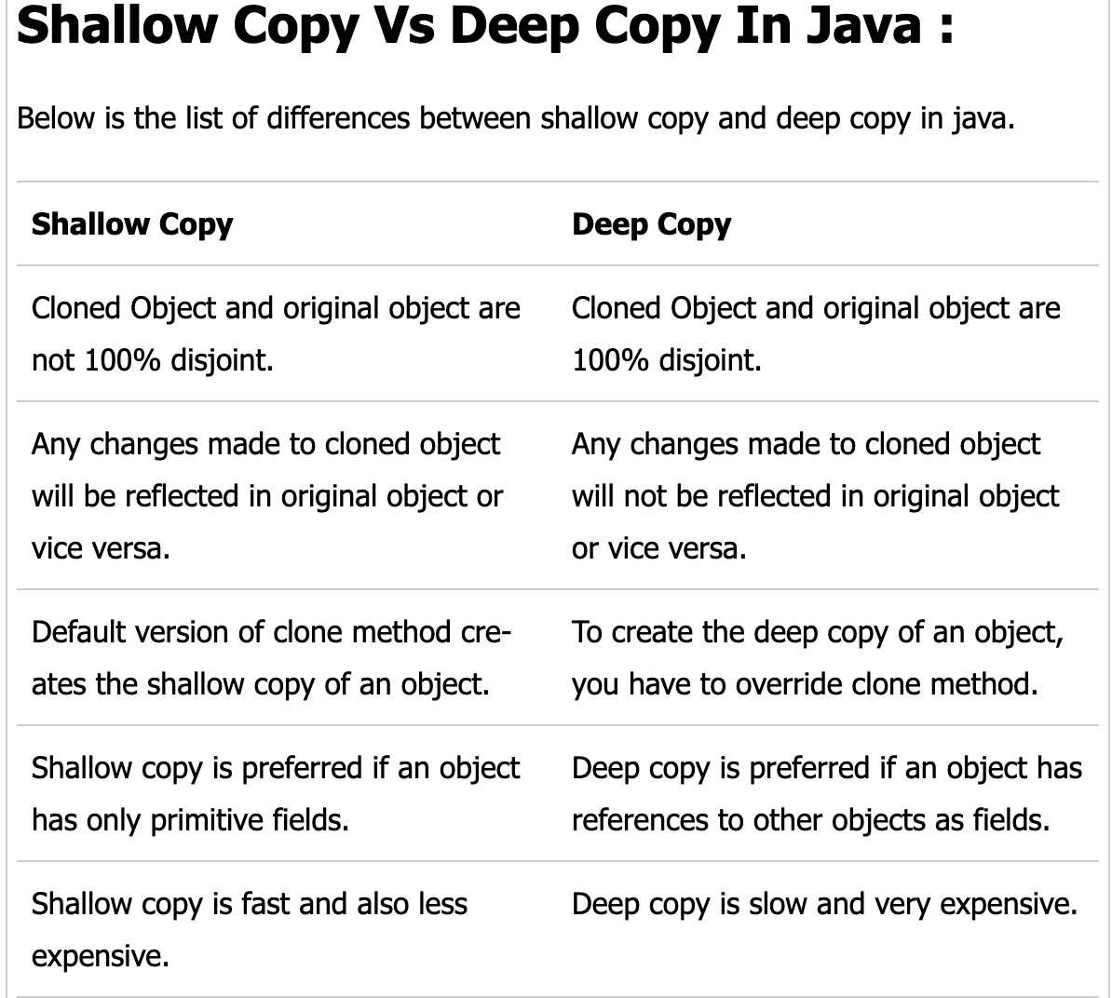
Notes:
(assuming a deep copy which goes to exhaustive depth)

Slide 40
Part II:
Input / Output streams

Slide 41
Input / Output (IO) Streams
Java provides specialised classes / APIs to deal with “streams” of bytes; used for the purposes of “communication”:
Input: Reading from a source
Output: Writing data to a target destination
Can be connected to many different kinds of sources and destinations, e.g. the console, local files, remote files, sockets, devices, memory arrays …
The communicated data can be low level (simple / raw bytes) or more specialised / high-level (e.g. Character Streams, Object Streams, etc)
Part of the java.io package
Not to be confused with java.util.streams.Stream, which is used for efficient processing of Collections
We will deal with these in a future lecture!
Also see “networked streams / io” (java.net / java.nio), zip-streams (java.util.zip) etc.

Slide 42
InputStream / OutputStream
Java provides InputStream and OutputStream as the base classes for reading and writing from / to binary systems.
Examples of streams:
System.in, System.out, System.err
FileReader, FileWriter
For text data, Java provides specialised wrappers:
InputStreamReader -> text wrapper for InputStream
OutputStreamWriter -> text wrapper for OutputStream
Commonly used with BufferedReader / BufferedWriter, for buffering the data / improving robustness and efficiency of reading / writing operations

Slide 43
import java.io.BufferedReader; import java.io.InputStreamReader; import java.io.IOException;
public class Main
{ public static void main( String [] args )
{ if (args.length == 0) { System.err.println( "Please provide input" ); System.exit(1); }
else if (args.length == 1 && args[0].equals("up") || args[0].equals("down")) { }
else { System.err.println( "Please use one of 'up' or 'down'" ); System.exit(1); }
BufferedReader b = new BufferedReader( new InputStreamReader( System.in ) );
String s;
try
{ while (true)
{ s = b.readLine(); if (s == null) { break; }
if (args[0].equals("up")) { System.out.println( s.toUpperCase() ); }
else { System.out.println( s.toLowerCase() ); }
}
}
catch (IOException e) { s = null; e.printStackTrace(); System.exit(1); }
}
}
Notes:
Leet’s try to see what this will do

Slide 44
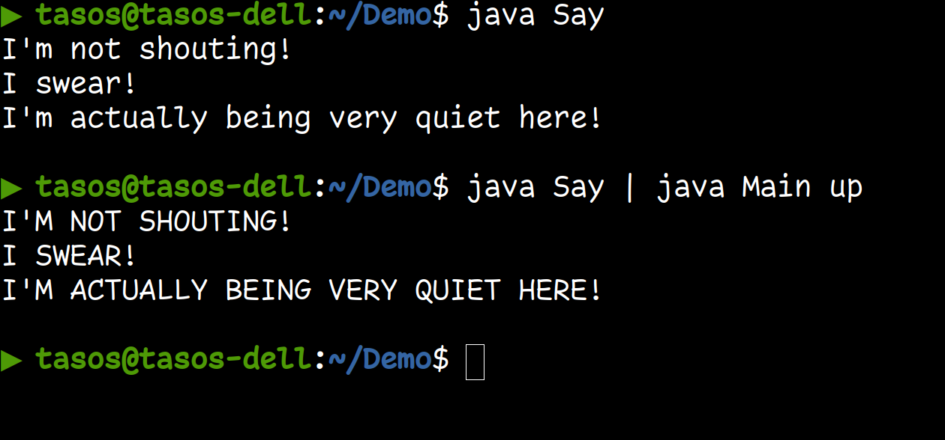
public class Say
{ public static void main( String [] args )
{ System.out.println( "I'm not shouting!" );
System.out.println( "I swear!" );
System.out.println( "I'm actually being very quiet here!" );
}
}
Note: If you try this on Windows, remember that you may have to specify the classpath explicitly, i.e. java -cp . Say | java -cp . Main up

Slide 45
Part III:
Serialisation and deserialisation

Slide 46
Serialisation
Serialisation is the process of saving Java objects into a stream
For objects to be eligible for serialisation, they need to implement the Serializable interface.
The Serializable interface does not actually provide any methods that need to be implemented.
Java provides a special kind of stream for doing this: ObjectOutputStream. e.g.:
ObjectOutputStream out = new ObjectOutputStream( new FileOutputStream( "bank.dat“ ) );
out.writeObject( “A String” ); out.writeObject( new Book() ); out.writeInt( 123 ); out.flush(); out.close()
Objects can be composed from other objects
includes reading/writing of all instance fields,
and all instance fields of those fields, etc.
Objects can be written using writeObject()
Primitives have their own methods, (e.g. writeInt), as per the DataOutput interface (implemented).
A single writeObject() invocation can lead to a large number of objects being written!
Notes:
Serialisation can be a way of doing a ‘deep’ copy … but you may grab more concrete objects than you bargained for!

Slide 47
De-serialisation
To read objects created via an ObjectOutputStream, use ObjectInputStream.
The relevant method to read the object is readObject()
For primitives, special methods exist (e.g. readInt) as per DataInput interface (implemented)
The deserialised object returned by readObject() is always returned as an instance of Object.
You need to know the type of object you are reading in, and cast appropriately. E.g.
ObjectInputStream in = new ObjectInputStream( new FileInputStream( "bank.dat“ ) );
BankAccount b = (BankAccount) in.readObject();
readObject() can throw a ClassNotFoundException and IOException
These are “checked” exceptions: you must either catch or declare them
If reading in more than one objects / variables from a stream you must do so in the right order (i.e. in which they were written), and casting as appropriate.

Slide 48
import java.io.Serializable; import java.io.IOException; import java.io.ObjectOutputStream;
import java.io.ObjectInputStream; import java.io.FileOutputStream; import java.io.FileInputStream;
class Book implements Serializable {
String title; String isbn; double price; String author;
public Book( String title, String isbn, double price, String author )
{ this.title = title; this.isbn = isbn; this.price = price; this.author = author; }
public boolean equals( Book b )
{ return this.title.equals(b.title) && this.isbn.equals(b.isbn) && this.price == b.price && this.author.equals(b.author); }
}
public class Main
{ public static void main( String[] args ) throws IOException, ClassNotFoundException
{ Book willows = new Book( "The Wind in the Willows", "0140621229", 1406, "Ken Grahame“ );
try (ObjectOutputStream out = new ObjectOutputStream( new FileOutputStream( "book.dat" ) ) )
{ out.writeObject(willows); } catch (Exception i) { i.printStackTrace(); }
try (ObjectInputStream in = new ObjectInputStream( new FileInputStream( "book.dat" ) ) )
{ Book willowsLoaded = (Book) in.readObject();
if (willowsLoaded.equals(willows)) { System.out.println( "(De)Serialization successful“ ); }
else { System.out.println( "If you reached this point, deserialization failed." ); }
} catch (Exception e) { e.printStackTrace(); }
}
}
Notes:
Let’s see a concrete example
(this is a simplified version of the book class from before)

Slide 49
Serialisation API
Enabled by implementing interface Serializable
Many standard classes implement this interface
Optionally, create (and initialise) a public static final long variable called serialVersionUID.
This is used as a 'version number' for the class, such that when java deserializes a Class type, it can check whether this is the same version as expected. (i.e. since the class might change between versions).
You can declare fields as transient, to mark them as “not for serialisation”.
Alternatively, populate a private static final ObjectStreamField[] serialPersistentFields variable with ObjectStreamField objects corresponding to the names and types of the fields you want to be serialized
See: https://docs.oracle.com/en/java/javase/17/docs/specs/serialization/serial-arch.html#defining-serializable-fields-for-a-class
Prerequisites for using Serializable:
all non-transient fields must be serialisable
if the parent class is not serialisable, then it must have an accessible “default” constructor (i.e. a constructor that takes no arguments), to initialise the state with “default” values.
Notes:
(note British vs American spelling)

Slide 50
Inner workings of Serialisation / Deserialisation
When writing objects to an ObjectOutputStream:
each object is assigned a serial number / handle in the stream, to be used as a ‘backreference’ if necessary
if the same object is saved twice in the same stream, only the serial number is written out the second time
writes whole object
transient and static (i.e. “class”) fields are ignored (with the exception of serialVersionUID, of course)
if a non-transient instance field cannot be serialised (e.g. Sockets cannot be serialised), the process will fail with a NotSerializableException
Objects are saved in a binary format
apart from the data, this also includes certain class properties, field names and types, the serialVersionUID…
On deserialization, the JVM reads the object, determines the class, loads it, and creates a new object
object instance variables are given values; static fields will refer to the class’s static fields as normal
transient fields get a null value for reference (non-primitive) types and defaults (0, false, …) for primitive types

Slide 51
Serialisation: The Version Problem
Problem with different versions of a class
suppose attributes are added, deleted, or modified?
how to read in previously saved objects in this case?
Serious problem for long-term persistence!
De-serialisation algorithm can deal with some changes:
adding new instance variables, changing instance variable access level, change of inheritance tree
typically get null/default values for new fields
If you want the JVM to de-serialise objects belonging to an older version of a class, set serialVersionUID for the class
Otherwise this identifier will be computed automatically, so it will change whenever the class is changed
The JVM will attempt de-serialisation of an object if the UID of the serialised and current class are the same

Slide 52
Further considerations
Very easy to store / load objects
Can be used for deep cloning, although that tends to be slower than field-by-field cloning
Major scalability problems, as it reads / writes large objects in one go
difficult to pick out particular parts
infeasible for very large objects
Potential version problems if the Java class has changed since the object was stored
Potential problems with serialising objects from third-party libraries if they were not tagged as serializable

Slide 53
Part IV:
JSON and GSON

Slide 54
JSON Data-Interchange Format
Java serialisation only works between Java programs
How to exchange data more generally?
JSON is a text format that can represent objects
Human-readable and editable (within limits)
Derived from “JavaScript Object Notation”
Supported in many different programming languages with libraries for (de-)serialisation, parsers, etc.
Popular for web applications and for web-services

Slide 55
JSON Format
Primitive values: strings, numbers, booleans, or null:
"abc", 123, true, false, null
Two data structures: objects and arrays
An object (“record”, “dictionary”…) is an unordered collection of name/value pairs
{"field1": value1, "field2": value2, …}
Do not forget the quotes around the field names!
An array is an ordered collection of values:
[value1, value2, …]
JSON objects are just “data”
No inbuilt “unique identifier” such as the JVM address

Slide 56
Support of JSON in Java
Limited support by standard Java libraries
One of the best libraries is Gson ( https://github.com/google/gson )
Other notable libraries:
Jackson (https://github.com/FasterXML/jackson )
JSON-P ( https://www.oracle.com/technical-resources/articles/java/json.html )

Slide 57
Gson
Open source library to convert Java objects to JSON and back
Created by Google developers, distributed as a jar-file
Does not require annotation of classes
Supports generics and nested classes
Ignores static and transient fields by default
i.e. these will not be written to the JSON object (i.e. similar to Java serialisation).
However, can be configured to also include these values too in GsonBuilder
(e.g. see https://github.com/google/gson/blob/master/UserGuide.md#TOC-Excluding-Fields-From-Serialization-and-Deserialization )

Slide 58
Gson: Basic Usage
import com.google.gson.Gson; import java.io.IOException;
public class GsonExample
{ public static void main ( String[] args ) throws IOException {
Gson gson = new Gson(); Author author = new Author( "01", "Joyce, James“ );
// serialisation
String authorJson = gson.toJson( author ); System.out.println( "Json: " + authorJson );
// round trip: de-serialisation of serialised object
Author authorCopy = gson.fromJson( authorJson, Author.class );
System.out.println( "Round trip: " + authorCopy );
}
}

Slide 59

Gson: Basic Usage
import com.google.gson.Gson; import java.io.IOException;
public class GsonExample
{ public static void main ( String[] args ) throws IOException {
Gson gson = new Gson(); Author author = new Author( "01", "Joyce, James“ );
// serialisation
String authorJson = gson.toJson( author ); System.out.println( "Json: " + authorJson );
// round trip: de-serialisation of serialised object
Author authorCopy = gson.fromJson( authorJson, Author.class );
System.out.println( "Round trip: " + authorCopy );
}
}

Slide 60
Example: A List of Books serialised to JSON
[ { "isbn": "0-13-110362-8",
"price": 42.0,
"title": "The C Programming Language",
"authors": [
{ "id": "KERN", "name": "Kernighan, Brian" },
{ "id": "RITC", "name": "Ritchie, Dennis" } ]
},
{ "isbn": "0-201-83595-9",
"price": 29.95,
"title": "The Mythical Man-Month",
"authors": [
{ "id": "BROO", "name": "Brooks, Frederick P." } ]
}, …
]

Slide 61
import com.google.gson.*; import com.google.gson.reflect.TypeToken; import java.io.*; import java.lang.reflect.Type; import java.nio.file.*; import java.util.List;
public class BooksJson
{ public static final String BOOKS_JSON_FILE = "Books.json";
public static final String BOOKS_JSON_COPY_FILE = "Books_copy.json";
public static final Gson GSON = new GsonBuilder().setPrettyPrinting().disableHtmlEscaping().create();
public static void writeBooks( List<Book> books, String fileName ) throws IOException
{ Path path = Paths.get( fileName ); BufferedWriter writer = Files.newBufferedWriter( path );
GSON.toJson( books, writer ); writer.close(); System.out.println();
}
public static List<Book> readBooks( String fileName ) throws IOException {
Path path = Paths.get( fileName ); BufferedReader reader = Files.newBufferedReader( path );
Type t = new TypeToken<List<Book>>(){}.getType(); List<Book>result = GSON.fromJson( reader, t );
reader.close(); return result;
}
public static void main(String[] args) throws IOException {
List<Book> books = BooksJson.readBooks( BOOKS_JSON_FILE );
for (Book book : books) { System.out.println( book ); }
BooksJson.writeBooks( books, BOOKS_JSON_COPY_FILE );
}
}

Slide 62
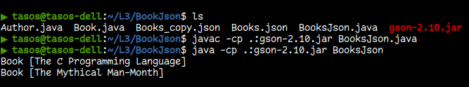
import com.google.gson.*; import com.google.gson.reflect.TypeToken; import java.io.*; import java.lang.reflect.Type; import java.nio.file.*; import java.util.List;
public class BooksJson
{ public static final String BOOKS_JSON_FILE = "Books.json";
public static final String BOOKS_JSON_COPY_FILE = "Books_copy.json";
public static final Gson GSON = new GsonBuilder().setPrettyPrinting().disableHtmlEscaping().create();
public static void writeBooks( List<Book> books, String fileName ) throws IOException
{ Path path = Paths.get( fileName ); BufferedWriter writer = Files.newBufferedWriter( path );
GSON.toJson( books, writer ); writer.close(); System.out.println();
}
public static List<Book> readBooks( String fileName ) throws IOException {
Path path = Paths.get( fileName ); BufferedReader reader = Files.newBufferedReader( path );
Type t = new TypeToken<List<Book>>(){}.getType(); List<Book>result = GSON.fromJson( reader, t );
reader.close(); return result;
}
public static void main(String[] args) throws IOException {
List<Book> books = BooksJson.readBooks( BOOKS_JSON_FILE );
for (Book book : books) { System.out.println( book ); }
BooksJson.writeBooks( books, BOOKS_JSON_COPY_FILE );
}
}

Slide 63
Comments about Book List Example
GsonBuilder for creating a configured Gson instance
Gson can read / write from files via readers / writers
Don’t forget to close these when you are done with them!
setPrettyPrinting() configures Gson to output Json that fits in a page for pretty printing.
disableHtmlEscaping. By default, Gson escapes HTML characters such as <>. Use this option to configure Gson to pass-through HTML characters as is
Use of Type and TypeToken for deserialisation of generics
This is necessary because the Java compiler erases information about type parameters in generics – we will discuss this further later on in this module

Slide 64
Concluding Remarks about Gson
Gson serialises whole “object trees” similar to Java's serialisation, but it does not include JVM addresses nor types
It parses numbers by default as Double values; this can occasionally cause problems when you try to de-serialise generic types instantiated with integer type parameters
Both serialisation and de-serialisation can be customised
In particular you can exclude certain fields
You can even code custom (de)serialisation for a class
Please see the online user guide for more details:
https://github.com/google/gson/blob/master/UserGuide.md

Slide 65
Summary
How to copy objects
Deep vs Shallow copying (or cloning)
Input / Output streams
Serialisation
JSON?
And libraries that make use of it (GSON)

Slide 66
Academic hours: Wednesdays 09:00-11:00 (please email if you can)
Notes:
Announcement that next week (6) will be the release of the assignment.
Also remind progress tests on week 7

